Slide 1
Maximum-likelihood estimation
A general method for estimating parameters in a model

Slide 2
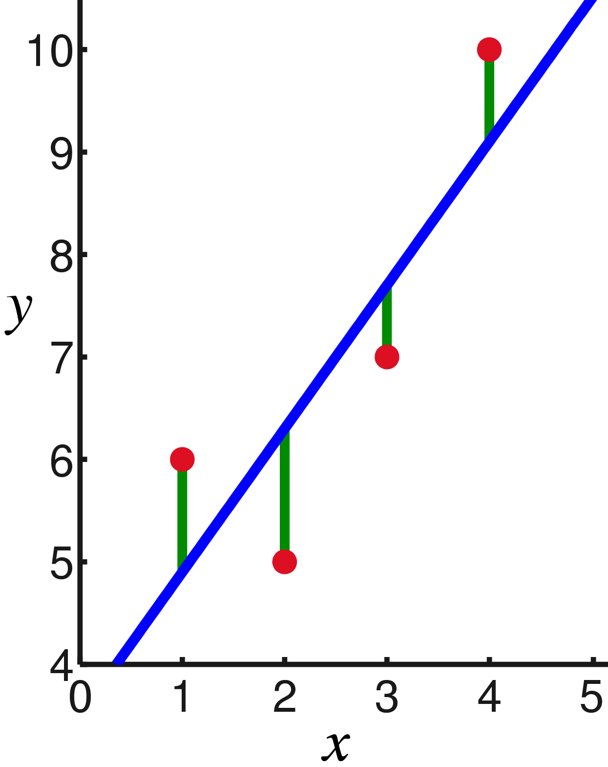
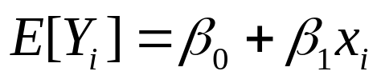
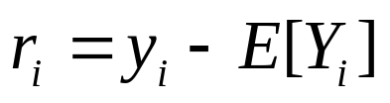
The method of least-squares
Model for the expectation (fixed part of the model):
Residuals:
The method of least-squares:
Find the values for the parameters (β₀ and β₁) that makes the sum of the squared residuals (Σr_{j}²) as small as possible.
Can only be used when the error term is normal (residuals are assumed to be drawn from a normal distribution)

Slide 3
Model for the expectation (fixed part of the model):
Residuals:
The maximum likelihood method is more general!
- Can be applied to models with any probability distribution

Slide 4
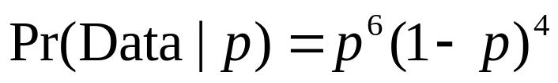
The maximum likelihood
Example:
We want to estimate the probability, p, that individuals are infected with a certain kind of parasite.
Probability of observation:
The maximum likelihood method (discrete distribution):
Write down the probability of each observation by using the model parameters
Write down the probability of all the data
Find the value parameter(s) that maximize this probability
Ind.:
Infected:
1
1
p
2
0
1-p
3
1
p
4
1
p
5
0
1-p
6
1
p
7
1
p
8
0
1-p
9
0
1-p
10
1
p

Slide 5
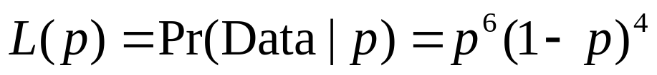
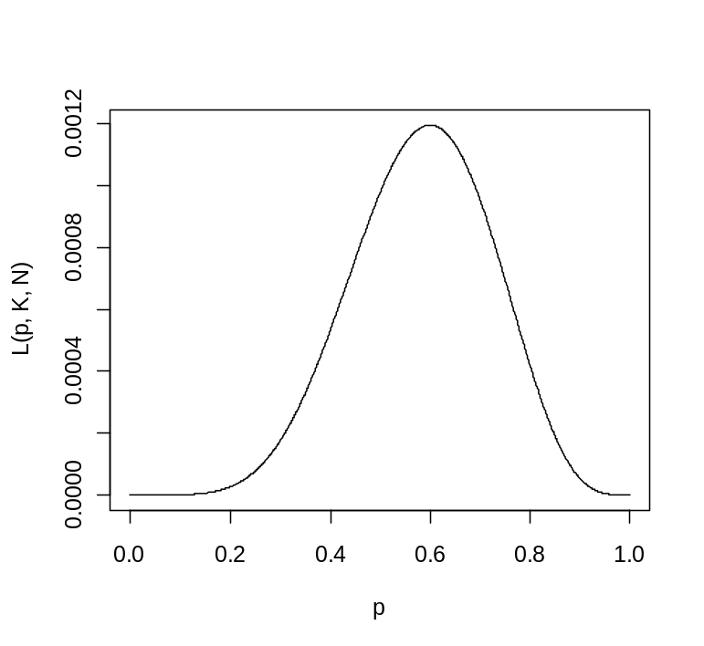
The maximum likelihood
Example:
We want to estimate the probability, p, that individuals are infected with a certain kind of parasite.
Probability of observation:
Likelihood function:
Ind.:
Infected:
1
1
p
2
0
1-p
- Find the value parameter(s) that maximize this probability
3
1
p
4
1
p
5
0
1-p
6
1
p
7
1
p
8
0
1-p
9
0
1-p
10
1
p

Slide 6

Exercises!

